Slide 1

OBC proposal
Filip Kus

Slide 2

Problem definition
Microcontroller
Data Handling
Data Storage
Telemetry and Teleoperation
Operational Modes
OS

Slide 3
Microcontroller

Slide 4
Selection Criteria for microcontroller
Microcontroller type
Memory
Non-volatile
Volatile
8-bit
16-bit
32-bit
SRAM
Flash
DRAM
EEPROM
Operating Temperature Range
Operating Voltage
-40 to 125 ˚C
2.2 to 3.6 V

Slide 5
Data Handling

Slide 6
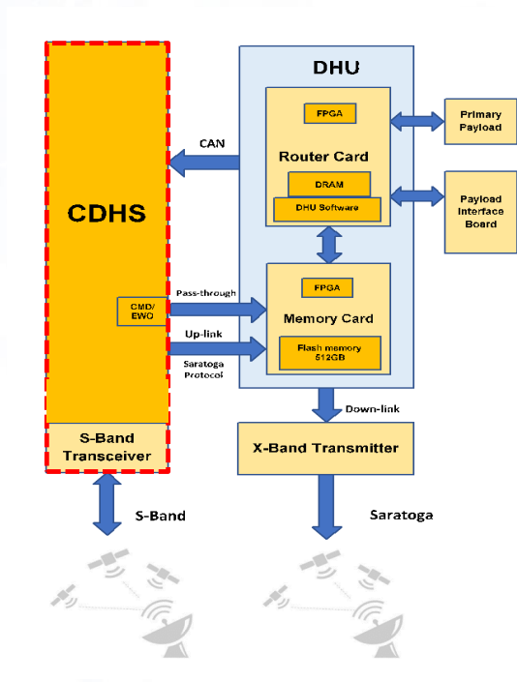
Data handling Unit
External Memory
Telemetry
SD Card
4 GB
TM Space Data Link
TC Space Data Link
Transmission
AOS Space Data Link
Transceiver
(not sure what band)
Proximity-1 Space Link

Slide 7
Operational Modes

Slide 8
Operational Modes
Single-Loop Controller
“Single-loop control (i.e., a control loop with one input and one output) is implemented in various versions of the proportional, integral, derivative control algorithm in modern distributed control systems”
Multi-Loop Controller
“A multi-loop controller is an electronic device used in a closed loop system to read multiple input values from a number of measuring devices and provide controlled outputs to achieve”

Slide 9
Operating System

Slide 10

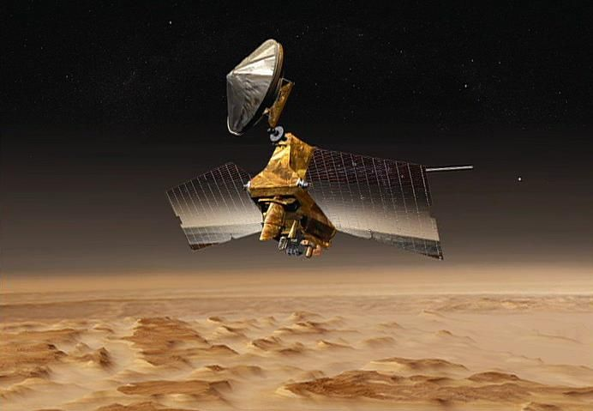
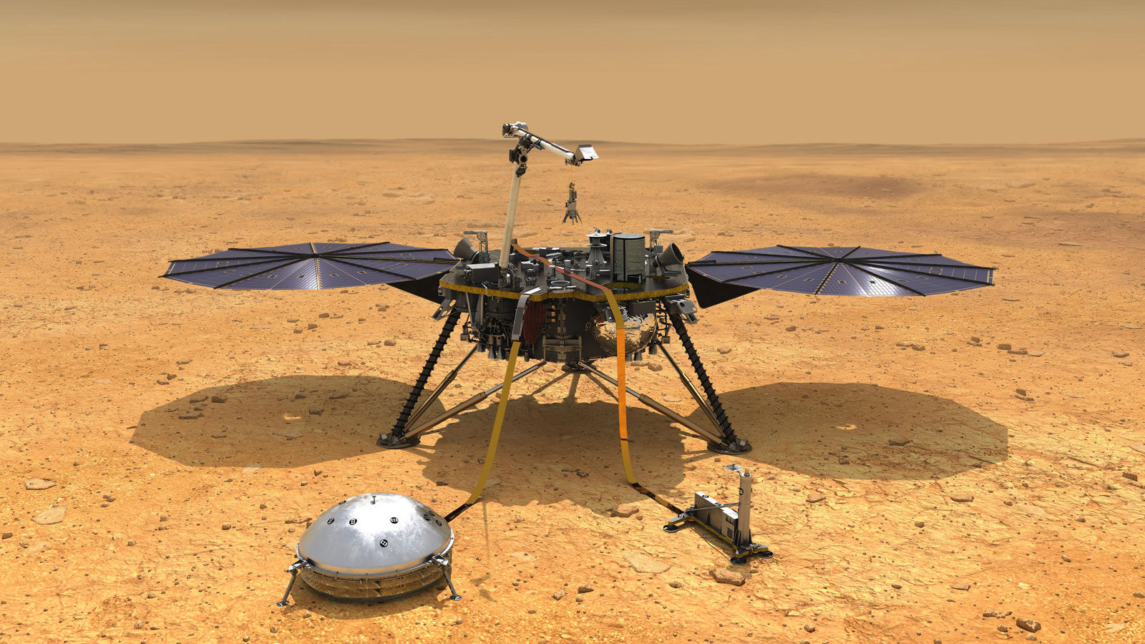
Operating System
VxWorks
RTEMS

